Slide 1
COMPSCI 220
Programming Methodology

Slide 2
The reduce function
We present three functions that cannot be written using map.
We derive the reduce function.
We draw reduce.
We derive the type of reduce.
We present several examples of reduce (counting odd and even numbers, partitioning an array into odd and even numbers, calculating statistics of an array).
We present the built-in reduce function.
We write map and filter using reduce

Slide 3
Three different functions
Problem Statement: Write a function that consumes an array of numbers and produces the sum of all the elements in the array.
Example: sum([3, 20, 100]) // 123
Type Signature: sum( a: number[]): number
Solution:
function sum(a) {
let result = 0;
for (let i = 0;
i < a.length;
++i) {
result = result + a[i];
}
return result;
}
Problem Statement: Write a function that consumes an array of numbers and produces the product of all the elements of the array.
Example: prod([2, 3, 4]) // 48
Type Signature: prod( a: number[]): number
Solution:
function prod(a) {
let result = 1;
for (let i = 0;
i < a.length;
++i) {
result = result * a[i];
}
return result;
}
Problem Statement: Write a function that consumes an array of strings and produces a the sum of the lengths of all the strings in the input array.
Example: lenAll([
'compsci',
'220']); // 10
Type Signature: lenAll( a: string[]): number
Solution:
function lenAll(a) {
let result = 0;
for (let i = 0;
i < a.length;
++i) {
result = result + a[i].length;
}
return result;
}
Can we use map to write these functions?

Slide 4
Deriving a new higher-order function
Ignore lenAll for a moment.
Step 1: Identify the differences between sum and prod.
function sum(a) {
let result = 0;
for (let i = 0;
i < a.length;
++i) {
result = result + a[i];
}
return result;
}
function prod(a) {
let result = 1;
for (let i = 0;
i < a.length;
++i) {
result = result * a[i];
}
return result;
}
Note: There are two differences between these functions. In contrast, when we derived map earlier, there was only one difference between the functions.
Step 2: Abstract out the differences.
let sumInit = 0;
function sumF(r, x) {
return r + x;
}
function sum(a) {
let result = sumInit;
for (let i = 0;
i < a.length;
++i) {
result = sumF(result, a[i]);
}
return result;
}
let prodInit = 1;
function prodF(r, x) {
return r * x;
}
function prod(a) {
let result = prodInit;
for (let i = 0;
i < a.length;
++i) {
result = prodF(result, a[i]);
}
return result;
}
Note: The only difference is the name of the variable they refer to.
Step 3: Make the differences an argument.
function reduce(init, f, a) {
let result = init;
for (let i = 0;
i < a.length;
++i) {
result = f(result, a[i]);
}
return result;
}
function sum(a) {
return reduce(0,
function(r, x) {
return r + x;
}, a);
}
function prod(a) {
return reduce(1,
function(r, x) {
return r * x;
}, a);
}
Note: The code above uses anonymous functions for compactness.

Slide 5
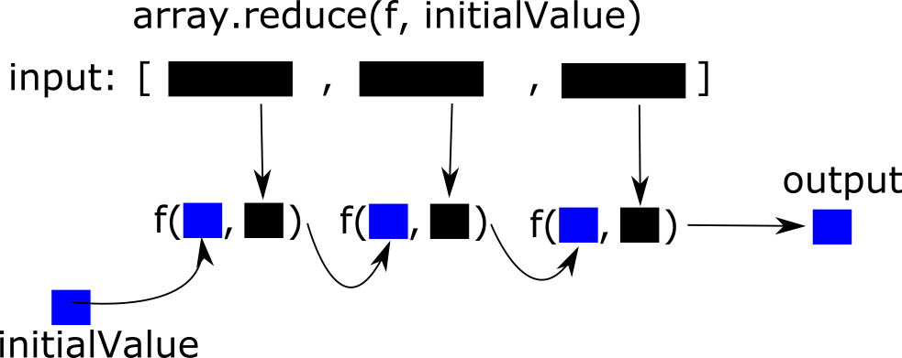
The reduce function, pictorially
reduce(init, f, a)
a:
init
Notes:
Sadly, I could not edit the image. Instead of rebuilding it, there is an ugly hack that overlays text on this slide.

Slide 6
What is the type of reduce?
// reduce(init: ___, f: (___, ___) => ___, a: ___[]): ___
function reduce(init, f, a) {
let result = init;
for (let i = 0; i < a.length; ++i) {
result = f(result, a[i]);
}
return result;
}
// reduce<A, B>(init: A, f: (A, B) => A, a: B[]): A
The argument f is a function that takes two arguments.
The argument a is an array.
The arrows indicate which types must be the same.

Slide 7
More reduce examples
Write lenAll using reduce.
// lenAll(a: string[]): number
function lenAll(a) {
let result = 0;
for (let i = 0; i < a.length; ++i) {
result = result + a[i].length;
}
return result;
}
Two questions:
What is the initial value?
What is the combining function?
// combine(r: number, x: string): number
function combine(r, x) {
return r + x.length;
}
// lenAll(a: string[]): number
function lenAll(a) {
return reduce(0, combine, a);
}
Notice that the types do not have to be the same!
Problem Statement: Write a function that consumes an array of numbers and produces the number of odd and even numbers in the array.
Example: countOddEven([1, 2, 3])
// { odd: 2, even: 1 }
Type Signature: countOddEven(a: number[]): { odd: number, even: number }
Solution:
// combine(r: { odd: number, even: number },
// x: number): { odd: number, even: number }
function combine(r, x) {
if (x % 2 === 0) {
return { odd: r.odd, even: r.even + 1 };
} else {
return { odd: r.odd + 1, even: r.even };
}
function countOddEven(a) {
return reduce({ odd: 0, even: 0 }, f, a);
}

Slide 8
More reduce examples
Problem Statement: Write a function that consumes an array of numbers and produces two arrays of odd and even numbers from the input array.the number of odd and even numbers in the array.
Example: sepOddEven([1, 2, 3])
// { odd: [1, 3], even: [2] }
Type Signature: sepOddEven(a: number[]): { odd: number[], even: number[] }
Solution:
// combine(r: { odd: number[], even: number[] },
// x: number): { odd: number[], even: number[] }
function combine(r, x) {
if (x % 2 === 0) {
r.evens.push(x);
return r;
} else {
r.odds.push(x);
return r;
}
}
function sepOddEven(a) {
return reduce({ odd: [], even: [] }, combine, a);
}

Slide 9
More reduce examples
Problem Statement: Write a function that consumes an array of numbers and the number of elements, the maximum, minimum, and mean.
Example: stats([0, 1, 2, 3, 4, 5, 6, -9.95]
// { mean: 1.38125, max: 6, min, -9.95, n: 8 }
Type Signature: stats(a: number[]): { mean: number, max: number, min: number, n: number }
Solution:
There is a simple solution that involves calling reduce several times. There is an uglier solution that only calls reduce once. In this class, we favor simple solutions, even if they are less efficient. But, it is a good exercise to try to solve this with just one call to reduce.
function stats(a) {
if (a.length < 1) {
// These statistics don't have any meaning for an empty list.
assert(false);
}
let init = { mean: 0, max: a[0], min: a[0], n: 0 };
return reduce(init,
function(r, x) {
return { min: Math.min(r.min, x), max: Math.max(r.max, x),
mean: (r.mean * r.n + x) / (r.n + 1); n: r.n + 1 };
}, init);
}

Slide 10
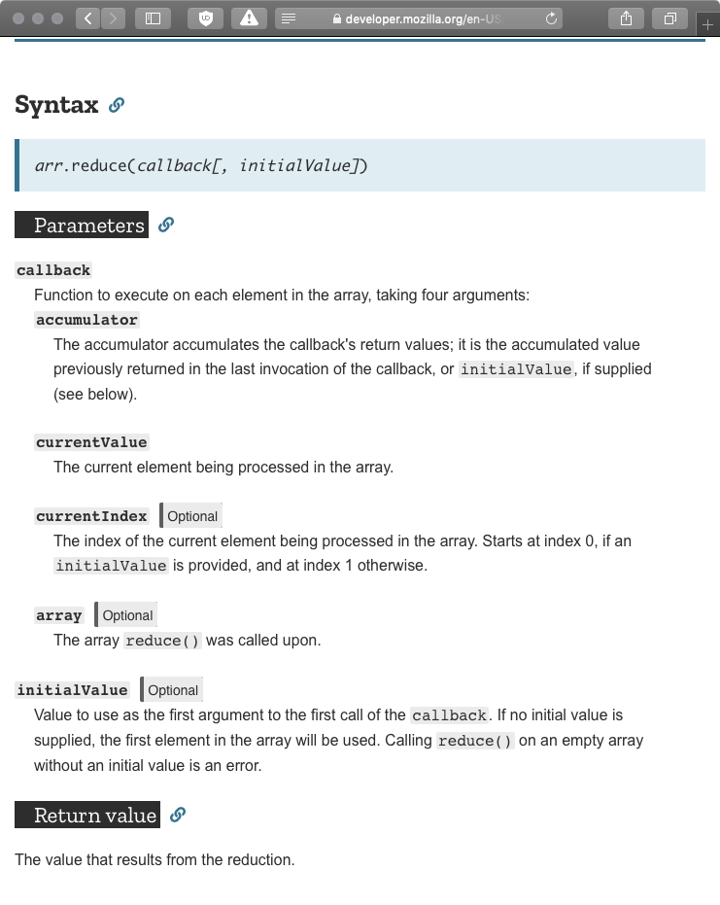
The builtin .reduce method
// sum(a: number[]): number
function sum(a) {
function f(r, x) {
return r + x;
}
return a.reduce(f, 0);
}
Do not use the currentIndex and array arguments.
Always provide an initial value.

Slide 11
Using reduce to write map
Problem Statement: Write a function that consumes an array of numbers and produces an array of numbers. Each element of the output array should be the double of the corresponding element in the input array.
Example: doubleAll([10, 5, 2]) // [20, 10, 4]
Type Signature: doubleAll(a: number[]): number[]
Does this look familiar? This was the first function we wrote using map. Can we write it with reduce?
Solution:
function doubleAll(a) {
function combine(r, x) {
r.push(x * 2);
return r;
},
return reduce([], combine, a);
}
Any function that you can write with map, you can rewrite using reduce itself. However, the solution that uses map is typically simpler than the solution that uses reduce.
In fact, you can write map using reduce.
function map(f, a) {
function combine(r, x) {
r.push(f(x));
return r;
},
return reduce([], combine, a);
}

Slide 12
Using reduce to write filter
Problem Statement: Write a function that consumes an array of numbers and produces an array of the even numbers in the input array.
Example: evens([10, 5, 2]) // [10, 4]
Type Signature: evens(a: number[]): number[]
Does this look familiar? This was the first function we wrote using filter. Can we write it with reduce?
Solution:
function evens(a) {
function combine(r, x) {
if (x % 2 === 0) {
r.push(x);
}
return r;
},
return reduce([], combine, a);
}
Any function that you can write with filter, you can rewrite using reduce itself. However, the solution that uses filter is typically simpler than the solution that uses reduce.
In fact, you can write filter using reduce.
function filter(pred, a) {
function combine(r, x) {
if (pred(x)) {
r.push(x);
}
return r;
},
return reduce([], combine, a);
}

Slide 13
Map and filter are specializations of reduce
Q: We can write map using reduce. But, can we write reduce using map? Why or why not?
A: map always produces an array. There are examples where reduce does not produce an array. So, those examples cannot be rewritten using map.
Q: Can we write reduce using filter?
A: Similar to the answer above.
Q: Can we write filter using map?
A: The length of the array produced by map is always the same as the length of input array. However, there are examples where filter produces an array with fewer elements than the input array.
Other answer are possible. Try to think of alternate reasons.

Slide 14
Unit Testing for Higher-Order Functions
Unit testing (non-higher order) functions:
Provide well-defined inputs
Verify outputs are correct
Test over sufficient inputs to ensure code coverage
Unit testing higher order functions:
Exactly the same procedure
Test inputs will include functions
Test over sufficient inputs to ensure code coverage Account for interactions between functional inputs and non-functional values

Slide 15
Properties of map and Unit Tests
Is this implementation of map correct?
function map(f, a) {
function combine(r, x) {
r.push(f(x));
return r;
},
return reduce([], combine, a);
}
Key Properties of Map
The return type is an array.
The returned array is a new array, not the original
The size of the output array must match the input array
The values in the output array must match the function applied to input array values
test("result of map is an array", function() {
let f = function(x) { return x; };
let a1 = [1, 2, 3];
let a2 = map(f, a1);
assert(typeof(a2) === 'object');
});
test("Map returns new array", function() {
let f = function(x) { return x; };
let a1 = [1, 2, 3];
let a2 = map(f, a1);
assert(a1 !== a2);
});
test("Map returns same length array", function() {
let f = function(x) { return x; };
let a1 = [1, 2, 3];
let a2 = map(f, a1);
assert(a1.length === a2.length);
});
test("Map returns correct array values", function() {
let f = function(x) { return 2 * x; };
let a1 = [1, 2, 3];
let a2 = map(f, a1);
assert(a2[0] === 2);
assert(a2[1] === 4);
assert(a2[2] === 6);
});

Slide 16
Properties of filter and Unit Tests
function filter(pred, a) {
function combine(r, x) {
if (pred(x)) {
r.push(x);
}
return r;
},
return reduce([], combine, a);
}
test("Return of filter is an array", function() {
let f = function(x) { return (x % 2) === 0 };
let a1 = [1, 2, 3];
let a2 = filter(a1, f);
assert(typeof(a2) === 'object');
});
test("Filter returns new array", function() {
let f = function(x) { return (x % 2) === 0 };
let a1 = [1, 2, 3];
let a2 = filter(a1, f);
assert(a1 !== a2);
});
test("Filter returns correct length", function() {
let f = function(x) { return (x % 2) === 0 };
let a1 = [1, 2, 3];
let a2 = filter(a1, f);
assert(a2.length === 1);
});
test("Filter returns correct values", function() {
let f = function(x) { return (x % 2) === 0 };
let a1 = [1, 2, 3];
let a2 = filter(a1, f);
assert(a2[0] === 2);
});

Slide 17
More Examples of Higher-Order Functions

Slide 18
Example: Function Composition
Math.cos(Math.abs(1));
Math.cos(Math.abs(2));
Math.cos(Math.abs(3));
Take 1: Using a higher-order function to compose two functions.
// compose<A,B,C>(f: (x: A) => B, g: (y: B) => C, x: A): C
function compose(f, g, x) {
let y = f(x);
return g(y);
}
compose(Math.cos, Math.abs, 1);
compose(Math.cos, Math.abs, 2);
compose(Math.cos, Math.abs, 3);
Each line calls Math.cos and Math.abs. Can we abstract away these repeated patterns?
This is still very repetitive. In fact, each line of code is actually longer!
Take 2: Using a HOF and nested functions.
// compose<A,B,C>(f: (x: A) => B, g: (y: B) => C): (x: A) => C
function compose(f, g) {
return function(x) {
let y = f(x);
return g(y);
}
}
let h = compose(Math.cos, Math.abs);
h(1);
h(2);
h(3);
Note that compose returns a new function.

Slide 19
Function Maximum
Problem Statement: Write a function that consumes an accepts a non-empty array of number-to-number functions and a number x. The function should produce produce the maximum value produced by any function in the array when applied to the argument x.
Type Signature:
maxF(funs: ((x: number) => number)[], x: number): number
Examples:
let funs = [function (x) { if (x % 2 === 0) { return 100; } else { return 0; } },
function (x) { if (x % 2 === 1) { return 200; } else { return 0; } },
function (x) { if (x < 0) { return 300; } else { return 0; } }];
maxF(funs, 0) // produces 100, which is the result of the 1st function
maxF(funs, -1) // produces 300, which is the result of the 3rd function
maxF(funs, 1) // produces 200, which is the result of the 2nd function
Solution using iteration
function maxF(funs, x) {
let y = ???;
???
return y;
}
Solution using iteration
function maxF(funs, x) {
let y = funs[0](x);
for (let i = 1; i < funs.length; ++i) {
y = Math.max(y, fns[i](x));
}
return y;
}
Solution using reduce
function maxF(funs, x) {
return funs
.reduce(function(y, f) { ??? }, ???);
}
Solution using reduce
function maxF(funs, x) {
return funs
.slice(1, funs.length - 1)
.reduce(function(y, f) { return Math.max(y, f(x)); },
funs[0](x));
}
Note that the type of f is (x: number) => number.
What should the initial value be?
Note that both solutions assume that the funs.length > 0.

Slide 20
Find The Bug! Program 1
function map(array, f) {
let callback = function(newArray, x) {
newArray.push(f(x));
}
return array.reduce(callback, []);
}
let a = [1, 2, 3, 4];
let f = function(x) {
return 2 * x;
};
let a2 = map(a, f);
console.log(a2);
Cannot read property 'push' of undefined at Line 3: in (anonymous function)
... Line 238: in (anonymous function)
... Line 13
Q1: What is the bug?
Q2: Why is this error thrown? Why "push"? Why "undefined"?
Notes:
This is an in-class activity. Write the program, walk through what it is supposed to do, and show the error being thrown. Ask students to discuss with their neighbors what is going on.

Slide 21
Common Errors Encountered Using Reduce
Incorrect type for initial value
Callback not returning a value
Callback return type does not match currentValue type
Callback passed to reduce accepts incorrect number of parameters
Callback passed to reduce accepts incorrect order of parameters
Notes:
YOU do NOT provide the argument to the function: the HOF will actually pass in the argument to the function you provided. This is especially dangerous if x is already defined somewhere!
The documentation for the HOF will specify what the signature of the callback function should be.

Slide 22
Solution: Program 1
function map(array, f) {
let callback = function(newArray, x) {
newArray.push(f(x));
return newArray;
}
return array.reduce(callback, []);
}
let a = [1, 2, 3, 4];
let f = function(x) {
return 2 * x;
};
let a2 = map(a, f);
console.log(a2);
Cannot read property 'push' of undefined at Line 3: in (anonymous function)
... Line 238: in (anonymous function)
... Line 13
Q1: What is the bug?
A: callback was not returning a result.
Q2: Why is this error thrown?
A: reduce passes the return from the last call of callback, to the next call of callback, as newArray
Notes:
This is an in-class activity. Write the program, walk through what it is supposed to do, and show the error being thrown. Ask students to discuss with their neighbors what is going on.

Slide 23
Find The Bug! Program 1
function map(array, f) {
let callback = function(newArray, x) {
newArray.push(f(x));
return f(x);
}
return array.reduce(callback, []);
}
let a = [1, 2, 3, 4];
let f = function(x) {
return 2 * x;
};
let a2 = map(a, f);
console.log(a2);
newArray.push is not a function at Line 3: in (anonymous function)
... Line 238: in (anonymous function)
... Line 16
Q1: What is the bug?
Q2: Why is this error thrown? Why push? Why is it not a function?
Notes:
This is an in-class activity. Write the program, walk through what it is supposed to do, and show the error being thrown. Ask students to discuss with their neighbors what is going on.

Slide 24
Solution: Program 1
function map(array, f) {
let callback = function(newArray, x) {
newArray.push(f(x));
return newArray;
}
return array.reduce(callback, []);
}
let a = [1, 2, 3, 4];
let f = function(x) {
return 2 * x;
};
let a2 = map(a, f);
console.log(a2);
Cannot read property 'push' of undefined at Line 3: in (anonymous function)
... Line 238: in (anonymous function)
... Line 13
Q1: What is the bug?
A: callback was not returning a correct type
Q2: Why is this error thrown?
A: reduce passes the return from the last call of callback, to the next call of callback, as newArray
Notes:
This is an in-class activity. Write the program, walk through what it is supposed to do, and show the error being thrown. Ask students to discuss with their neighbors what is going on.

Slide 25
More Examples

Slide 26
Exercise: Map, Reduce and Filter
Write a set of functions that takes as input an array of songs as an object:
{name: “Example Song”, artist: “220 Staff”}
And performs the following actions:
Return an array of just the song names
Return an array of the song names in lower case
Return only the songs that are by a given artist
Return the number of songs by a given artist
You can access the data with: elem.name and elem.artist

Slide 27
Return an Array of All Song Names
function allSongNames(songs) {
return songs.map(function(song){
return song.name;
});
}

Slide 28
Return an Array of All Song Names Lowercased
function allSongNamesLower(songs) {
return songs.map(function(song){
return song.name.toLowerCase();
});
}

Slide 29
Return List of All Song Names by an Artist
function songsByArtist(songs, artist) {
return songs.filter(function(song) {
return song.artist === artist;
});
}

Slide 30
Return Number of Songs by a Particular Artist
function songCount(songs, artist) {
return songs.reduce(function(accumulator, song){
if(song.artist === artist){
return accumulator += 1;
}else{
return accumulator;
}
},0);
}

Slide 31
Examples of Reduce
Question: Using reduce, write a new function called
concat(a1, a2) that creates a new array consisting of a2 appended to a1

Slide 32
Using reduce for concat
What is the type signature of the callback function?
Parameter 1 (current accumulator value)
Parameter 2 (element from array)
Return value (???)
How is the accumulator calculated each time?
What is the type of initial value, and how do we initialize it?

Slide 33
Using reduce for concat
Assume the input array contains elements of type T
What is the type signature of the callback function?
Parameter 1 Array[T]
Parameter 2 (element from array) T
Return value Array[T]
How is the accumulator calculated each time?
Push a new element
What is the type of initial value, and how do we initialize it?
Array[T]: Set to first input array

Slide 34
Exercise: Find the Bug
function concat(arr1, arr2) {
function callback(accumulator, x) {
accumulator.push(x);
return accumulator;
}
return arr2.reduce(callback, arr1);
}

Slide 35
Exercise: Find the Bug
function concat(arr1, arr2) {
function callback(accumulator, x) {
accumulator.push(x);
return accumulator;
}
return arr2.reduce(callback, arr1);
}
Our callback function is calling push on the accumulator, that will actually add elements to arr1 rather than building a completely new array

Slide 36
Exercise: Find the Bug
function concat(arr1, arr2) {
function callback(accumulator, x) {
accumulator.push(x);
return accumulator;
}
return arr2.reduce(callback, arr1.slice());
}
The slice method returns a copy of the array starting at the specified index (or 0 if no index is applied)

Slide 37
Exercise closestElement
Question: Using map and/or reduce, write a new function called
closestElement(array, x) that returns the element in the input array that is closest in value to x
Both x and the elements of array are numbers
If two elements are equidistant, the earlier element should be returned.
E.g. closestElement([1, 3, 5, 7, 9], 2) should return 1

Slide 38
Using reduce for closestElem
What is the type signature of the callback function?
Parameter 1 (current accumulator value)
Parameter 2 (element from array)
Return value (???)
How is the accumulator calculated each time?
What is the type of initial value, and how do we initialize it?

Slide 39
Using reduce for closestElem
Assume the input Array contains numbers
What is the type signature of the callback function?
Parameter 1 Number
Parameter 2 Number
Return value Number
How is the accumulator calculated each time?
What is the type of initial value, and how do we initialize it?
Number - First Element in the Array

Slide 40
closestElem
function closestElem(array, x) {
function callback(acc, elem) {
if (Math.abs(x - elem) < Math.abs(x - acc)) {
return elem;
} else {
return acc;
}
}
return array.reduce(callback, array[0]);
}

Slide 41
Problem: maxF
Q: Write a HOF that accepts: 1. An array of functions [f1, f2, etc.], and 2. A number x; and returns: max(f1(x), f2(x), ....)

Slide 42
maxF by map and reduce
map: Given [f1, f2, f3] produce [f1(x), f2(x), f3(x)]
reduce: Given numbers [x1, x2, x3] produce max value of them all

Slide 43
Revisiting closestElem
Question: Using reduce, write a new function called
closestElementF(array) that returns a function that takes a number as input and produces the value of the element in the array that is closest in to x

Slide 44
Using reduce for closestElemF
What is the type signature of the callback function?
Parameter 1 ?
Parameter 2 ?
Return value ?
What is the type of the initial value?
How do we initialize it?

Slide 45
Using reduce for closestElemF
What is the type signature of the callback function?
Parameter 1 : A function returning min over elem seen so far
Parameter 2 : Single number from array of values
Return value: A function returning min over the distances
What is the type of the initial value? A function
How do we initialize it? A function that returns the first element in the array

Slide 46
Using reduce for closestElemF
function closestElemF(array) {
function callback(minSoFar, elem) {
return function(x) {
let min = minSoFar(x);
if (Math.abs(min - x) < Math.abs(elem - x)) {
return min;
} else {
return elem;
}
}
}
return array.reduce(callback, function(x){return array[0]});
}

Slide 47
Exercise: Insertion Sort with Reduce
Pseudo code from Wikipedia: Recursive (Mostly)
Iterative
i ← 1 while i < length(A) x ← A[i] j ← i - 1 while j >= 0 and A[j] > x A[j+1] ← A[j] j ← j - 1 end while A[j+1] ← x i ← i + 1 end while
function insertionSortR(array A, int n) if n>0 insertionSortR(A,n-1)w x ← A[n] j ← n-1 while j >= 0 and A[j] > x A[j+1] ← A[j] j ← j-1 end while A[j+1] ← x end if end function

