Slide 1
A Mental Model of JavaScript
Part 2: Functions
Notes:
The “Shaky diagrams” in this slide deck were made with this tool:
http://shaky.github.bushong.net
The original source of each diagram is in the speaker notes, so that you do not have to recreate them if you want to edit them.

Slide 2
Summary from last class
Key principles of variables, objects, and memory:
The values are numbers, booleans, strings, and references to objects and arrays
Every variable stores a value
Every field in an object stores a value
An assignment, y = x creates a copy of the value in x and stores that copy in y
Important corollary: Objects are not values. Arrays are not values.
This principles are true for JavaScript and every other major programming language (with the exception of C++, where objects can be values).

Slide 3
Revision: Changing Variable Types
let a = [2, 3, 4];
// Do something: 1
a = 2;
// Do something: 2
a = { x: 2 };
// Do something: 3
a = function() {
console.log("Hello World");
}
// Do something: 4

Slide 4
Revision: Changing Variable Types
let a = [2, 3, 4];
// Do something: 1
a = 2;
// Do something: 2
a = { x: 2 };
// Do something: 3
a = function() {
console.log("Hello World");
}
// Do something: 4
Q: Where can these statements go?
a.x = 3;
a();
console.log(2 * a);
console.log(a.length);

Slide 5
Revision: How many objects will there be?
let a = [];
let b = { x: 0, y: 1 };
for (let i = 0; i < 100; ++i) {
a.push(b);
}
let a = [];
let b = { x: 0, y: 1 };
for (let i = 0; i < 100; ++i) {
b = { x: 0, y: 1 };
a.push(b);
}

Slide 6
Revision: Values, and Memory Map
let a = [];
let b = { x: 0, y: 1 };
for (let i = 0; i < 100; ++i) {
b = { x: 0, y: 1 };
a.push(b);
}
b.x = 5;
let s = a.reduce(function(sum, obj) { return sum + obj.x;}, 0);
console.log(s);

Slide 7
Mechanism of function calls
function f1(a, y) {
let b = a;
b.x = b.x + y;
return b;
}
let a = { x: 0 };
let y = 10;
let b = f1(a, y);
Parameters are passed in by copying values
Return values are returned by copying values
Beware: Objects are not values! References to objects are values.
What are the values of the variables, and the memory layout before, during, and after the function call?

Slide 8
Exercise: What will this program print, and why?
let a = { x: 0, y: 1 };
function doSomething(z) {
z.x = 42;
}
doSomething(a);
console.log(a);

Slide 9
Exercise: What will this program print, and why?
let a = { x: 0, y: 1 };
function doSomething(z) {
z = { x: 42, y: 1};
}
doSomething(a);
console.log(a);

Slide 10
Exercise: What will this program print, and why?
let a = { x: 0, y: 1 };
function doSomething(z) {
z.x = 42;
return z;
}
let b = doSomething(a);
b.x = 100;
console.log(a.x);

Slide 11
Exercise: What will this program print, and why?
let a = [];
let o = { x: 0 };
function f(a, o) {
for (let i = 0; i < 10; ++i) {
a.push(o);
}
o.x = 1;
return o;
}
let b = f(a, o);
b.x = 2;
console.log(a.reduce(function(a, b) { return a + b.x; }, 0));

Slide 12
Program Stacks
From 187
What’s really going on with recursion? How does the computer system handle recursive calls?
Computers use stacks to handle all method calls and returns. Method calls are executed in Last-In-First-Out (LIFO) fashion (recall the ‘clean your house’ example and all the additional tasks it incurred).
A method’s local variables and return link are kept in the stack memory. This is called a stack frame.
The run-time system has a limited amount of stack memory. Beyond that you will get StackOverflowException.

Slide 13
From 187
Available Stack Space
Frame [N]
Top Frame
return link to [N-1]
… …
Frame [1]
return link to [0]
Frame [0]
Bottom Frame
return link to caller

Slide 14
Stack example
function F() {
return 10;
}
function G() {
let x = F();
return x + 2;
}
let y = G();
console.log(y);
function F() {
return 10;
}
function G() {
let x = F();
return x + 2;
}
let y = G();
console.log(y);
function F() {
return 10;
}
function G() {
let x = F();
return x + 2;
}
let y = G();
console.log(y);
function F() {
return 10;
}
function G() {
let x = F();
return x + 2;
}
let y = G();
console.log(y);
function F() Frame:
return to line 5
function G() Frame:
x = undefined
function G() Frame:
x = undefined
function G() Frame:
x = 10
return to line 8
return to line 8
return to line 8
Top Frame:
y = undefined
Top Frame:
y = undefined
Top Frame:
y = undefined
Top Frame:
y = undefined
(end of program)
(end of program)
(end of program)
(end of program)
Notes:
The bold instruction is the current instruction and the yellow blocks are the stack frames. I would do this on the board:
Before calling G(), y is undefined
We enter G, pushing the address of the function call site onto the stack and allocate space for x
We enter F, pushing the address of the function call site onto the stack
We return 10 to the call site
... and so on

Slide 15
Stack example (contd.)
function F() {
return 10;
}
function G() {
let x = F();
return x + 2;
}
let y = G();
console.log(y);
function F() {
return 10;
}
function G() {
let x = F();
return x + 2;
}
let y = G();
console.log(y);
function F() {
return 10;
}
function G() {
let x = F();
return x + 2;
}
let y = G();
console.log(y);
function F() {
return 10;
}
function G() {
let x = F();
return x + 2;
}
let y = G();
console.log(y);
function G() Frame:
x = 10
return to line 8
Top Frame:
y = undefined
Top Frame:
y = 12
Top Frame:
y = 12
Top Frame:
y = 12
(end of program)
(end of program)
(end of program)
(end of program)
Notes:
The bold instruction is the current instruction and the yellow blocks are the stack frames. I would do this on the board:
Before calling G(), y is undefined
We enter G, pushing the address of the function call site onto the stack and allocate space for x
We enter F, pushing the address of the function call site onto the stack
We return 10 to the call site
... and so on

Slide 16
What is the value of z?
function F(x) {
let g = function(y) {
return x + y;
}
return g;
}
let h = F(10);
let z = h(2);
Answer: 12
But, does the model of the stack work?

Slide 17
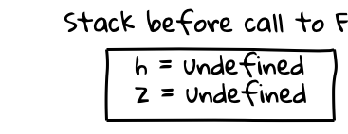
function F(x) {
let g = function(y) {
return x + y;
}
return g;
}
let h = F(10);
let z = h(2);
Notes:
Stack before call to F
+---------------+
| h = undefined |
| |
| z = undefined |
| |
+---------------+

Slide 18
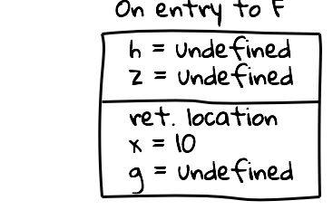
function F(x) {
let g = function(y) {
return x + y;
}
return g;
}
let h = F(10);
let z = h(2);
We push the return address (i.e., the address of the call-site of F) onto the stack
We push the value of the argument x onto the stack
Notes:
On entry to F
+---------------+
| h = undefined |
| |
| z = undefined |
| |
+---------------+
| ret. location |
| |
| x = 10 |
| |
| g = undefined |
| |
+---------------+

Slide 19
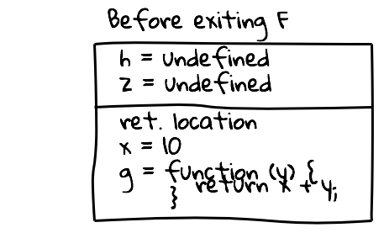
function F(x) {
let g = function(y) {
return x + y;
}
return g;
}
let h = F(10);
let z = h(2);
Notes:
We are already screwed. Do you see it? g has a reference to y, but the value of y is lost
Before exiting F
+---------------------+
| h = undefined |
| |
| z = undefined |
| |
+---------------------+
| ret. location |
| |
| x = 10 |
| |
| g = function (y) { |
| return x + y; |
| } |
| |
+---------------------+

Slide 20
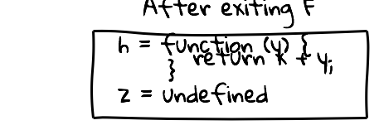
function F(x) {
let g = function(y) {
return x + y;
}
return g;
}
let h = F(10);
let z = h(2);
Notes:
We are already screwed. Do you see it? g has a reference to y, but the value of y is lost
After exiting F
+---------------------+
| h = function (y) { |
| return x + y; |
| } |
| |
| z = undefined |
| |
+---------------------+

Slide 21
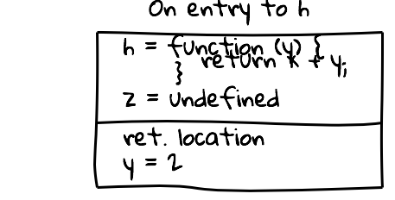
function F(x) {
let g = function(y) {
return x + y;
}
return g;
}
let h = F(10);
let z = h(2);
What is the value of x?
Notes:
How do we calculate x + y? We don’t know y anymore!
On entry to h
+---------------------+
| h = function (y) { |
| return x + y; |
| } |
| |
| z = undefined |
| |
+---------------------+
| ret. location |
| |
| y = 2 |
| |
+---------------------+

Slide 22
What went wrong?
In 121 / 187, you learned that local variables are stored on the stack. This is wrong for most programming languages that are not Java or C++.
We said that functions are values. This is not completely accurate either.

Slide 23
function F(x) {
let g = function(y) {
return x + y;
}
return g;
}
let h = F(10);
let z = h(2);
When we return g, we pop the stack frame that holds the value of x. Therefore when we call this function (with the name h), we get into trouble.
Notes:
The diagram is the same as an earlier one.

Slide 24
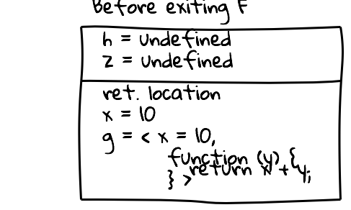
Solution: closures
function F(x) {
let g = function(y) {
return x + y;
}
return g;
}
let h = F(10);
let z = h(2);
g contains an object with two fields: (1) a dictionary that maps variables to their values and (2) the code of g.
Notes:
Before exiting F
+-----------------------+
| h = undefined |
| |
| z = undefined |
| |
+-----------------------+
| ret. location |
| |
| x = 10 |
| |
| g = < x = 10, |
| |
| function (y) { |
| return x + y; |
| } > |
| |
+-----------------------+

Slide 25
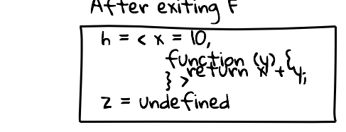
function F(x) {
let g = function(y) {
return x + y;
}
return g;
}
let h = F(10);
let z = h(2);
Notes:
After exiting F
+-----------------------+
| h = < x = 10, |
| |
| function (y) { |
| return x + y; |
| } > |
| |
| z = undefined |
| |
+-----------------------+

Slide 26
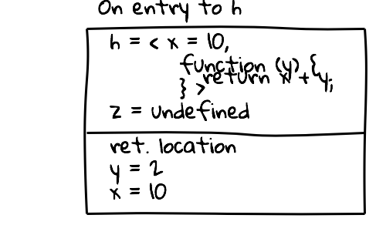
function F(x) {
let g = function(y) {
return x + y;
}
return g;
}
let h = F(10);
let z = h(2);
When we call a closure, we first restore the values saved in the closure object and then enter the function in the closure object.
Notice that both x and y are on the stack, so we will no problem calculating x + y.
Notes:
On entry to h
+-----------------------+
| h = < x = 10, |
| |
| function (y) { |
| return x + y; |
| } > |
| |
| z = undefined |
| |
+-----------------------+
| ret. location |
| |
| y = 2 |
| |
| x = 10 |
| |
+-----------------------+

Slide 27
Main principles
The values of JavaScript are numbers, booleans, strings, references to objects, references to arrays, and closures
Every variable stores a value
An assignment x = y creates a copy of the value in y and stores it in x
Every field in an object stores a value
A closure in an object with two fields: (1) the code of a function and (2) a dictionary that contains the values of variables that were in scope when the function was defined.
Are functions values? Not exactly. It is more precise to say that closures are values that contain functions
Notes:
Note: the dictionary is known as the “environment”

Slide 28
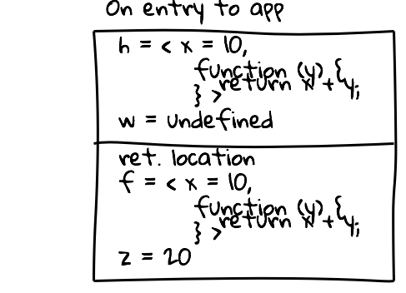
Another example
function F(x) {
let g = function(y) {
return x + y;
}
return g;
}
function app(f, z) {
return f(z);
}
let h = F(10);
let w = app(h, 20);
Compare this stack with the earlier example, when we called h(1) directly.
Notes:
On entry to app
+-----------------------+
| h = < x = 10, |
| |
| function (y) { |
| return x + y; |
| } > |
| |
| w = undefined |
| |
+-----------------------+
| ret. location |
| |
| f = < x = 10, |
| |
| function (y) { |
| return x + y; |
| } > |
| |
| z = 20 |
| |
+-----------------------+

Slide 29
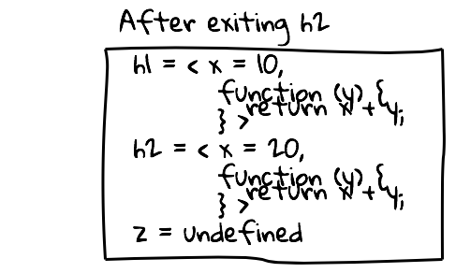
function F(x) {
let g = function(y) {
return x + y;
}
return g;
}
let h1 = F(10);
let h2 = F(200);
let z = h1(1) + h2(2000);
Work out all the steps of execution. Notice that the closures h1 and h2 both contain the same code, but they have different values for x.
Notes:
After exiting h2
+-----------------------+
| h1 = < x = 10, |
| |
| function (y) { |
| return x + y; |
| } > |
| |
| h2 = < x = 20, |
| |
| function (y) { |
| return x + y; |
| } > |
| |
| z = undefined |
| |
+-----------------------+

Slide 30
function F(x) {
let g = function(y) {
return x + y;
}
return g;
}
let h1 = F(3);
let h2 = F(h1(5));
let z = h2(10);
What is the value of x in the closure h2?

Slide 31
function F(x) {
let g = function(y) {
let r = x + y;
if (y === 0) {
x = 0;
}
return r;
}
return g;
}
let h = F(10);
let z = h1(0);
let w = h1(0);
What are the values of z and w?

Slide 32
function M0(f, x) {
return x;
}
console.log(M0(F, X));
Can you come up with values of F and X, such that this program prints 0?

Slide 33
function M0(f, x) {
return x;
}
function M1(f, x) {
return f(x);
}
console.log(M0(F, X));
console.log(M1(F, X));
Can you come up with values of F and X, such that this program prints 0 and 1?

Slide 34
function M0(f, x) {
return x;
}
function M1(f, x) {
return f(x);
}
function M3(f, x) {
return f(f(f(x)));
}
console.log(M0(F, X));
console.log(M1(F, X));
console.log(M3(F, X));
Can you come up with values of F and X, such that this program prints 0, 1, and 3?

Slide 35
function M0(f, x) {
return x;
}
function M1(f, x) {
return f(x);
}
function M3(f, x) {
return f(f(f(x)));
}
console.log(M0(F, X));
console.log(M1(F, X));
console.log(M3(F, X));
Can you come up with values of F and X, such that this program prints 0, 1, and 3?
Answer is:
X = 0
F = function(y) { return y + 1; }
Other crazier answers are also possible, but this is the simplest.

Slide 36
Exercise: What will this program print, and why?
let a = { x: 0, y: 1 };
function doSomething(z) {
z = { x: 42, y: 1};
return z;
}
let b = doSomething(a);
b.x = 100;
console.log(a.x);

Slide 37
Miscellaneous Points
Do you have to always think in closures? No! You need to think of closures when a function (1) is used as an argument to a higher-order function or (2) is nested within another function and uses variables declared in the enclosing function. So, the simpler mental model from 121/187 is still valuable.
Are closures expensive? No. For example, an implementation of JavaScript effectively use the simpler mental model when it is safe to do so and not create closures. Even when closures are created, they are not any slower than allocating an object.
Are closures just objects? Yes. Are objects just closures? Yes. Are they they same? Not exactly. A closure stores exactly one function (“the” function). An object may have multiple functions (i.e., methods).
Have we told you everything you need to know about closures? No.

Slide 38
Objects and Closures
function M(x) {
let f1 = function() {
return x;
}
let f2 = function(y) {
x = y;
}
return {
get: f1,
set: f2
};
}
let obj = M(100);
Run these in the terminal:
obj.get()
obj.set(20)
obj
obj.x
let obj2 = M(10);
obj.get / obj.set / obj2.get / obj2.set
How does this work?

Slide 39
function M(x) {
let f = function(y) {
let g = function() {
let r = x + y;
if (y === 0) {
x = 0;
}
return r;
}
return g;
}
return f;
}
let h = M(100);
console.log(h(0)());
console.log(h(0)());
According to our mental model of closures, what should this program display?
What does it actually display?

Slide 40
function M(x) {
let f = function(y) {
let g = function() {
let r = x.v + y;
if (y === 0) {
x.v = 0;
}
return r;
}
return g;
}
return f;
}
let h = M({ v: 100 });
console.log(h(0)());
console.log(h(0)());
According to our mental model of closures, what should this program display? (Work it out at home!)
What does it actually display?
Can we characterize when our mental model breaks down?
Answer: When a function assigns to a variable in its closure. x.v = 0 is not an assignment.
Thought experiment: come up with a mental model that actually works

